Slide 1

Chapter 7： DC-DC Switch-Mode Converters:
7-1 Introduction
7-2 Control of dc-dc Converters
7-3 Step-Down (Buck) Converter
7-4 Step-Up (Boost) Converter
7-5 Buck-Boost Converter
7-6 Cuk dc-dc Converter
7-7 Full Bridge dc-dc Converter
7-8 dc-dc Converter Comparison

Slide 2
本章知识点：
1、掌握Buck变换器、Boost变换器和Buck-Boost变换器的工作原理和参数设计；
2、理解Cuk变换器的工作原理和性能。

Slide 3
7-4 BOOST CONVERTER
7-4 Step-Up (Boost) Converter
（升压变换器or Boost变换器）
Applications: Step-up converter is mainly applied in regulated dc power supplies and regenerative braking of dc motors.
i
L
D
i
L
D
+
+
V
-
L
i
+
s
V
V
R
d
C
o
-
-
Output voltage must be greater than the input

Slide 4
7-4 BOOST CONVERTER
7-4-1 continuous-conduction mode ☆
i
L
D
i_{D}
L
+
+
V
-
L
+
1 Operation principle
(a)
i
s
C
R
V
V
d
o
-
-
(1) Turning on the switch applies the voltage V_{d} across the inductor, v_{L}=V_{d}, and i_{L} linearly ramps up, increasing the energy in the inductor.
v_{L}
(V_{d})
(b)
t
(V_{d}-V_{o})
T_{s}
i_{L}
(2) Turning off the switch forces the inductor current to flow through the diode, some of the stored energy is transferred to the output stage.
I_{L}
(c)
0
t
t_{on}
t_{off}
i_{s}
(d)
0
t
i_{D}
(e)
0
t

Slide 5



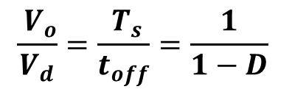
7-4 BOOST CONVERTER
2 Steady-state analysis:
i
L
D
i_{D}
L
+
+
V
-
In the dc steady state:
L
+
(a)
i
s
C
R
V
V
d
o
-
-
v_{L}
(V_{d})
(b)
t
(V_{d}-V_{o})
T_{s}
i_{L}
(c)
I_{L}
0
t
t_{on}
t_{off}
i_{s}
V_{o} can be controlled by varying the duty ratio D.
(d)
0
t
i_{D}
(e)
0
t

Slide 6
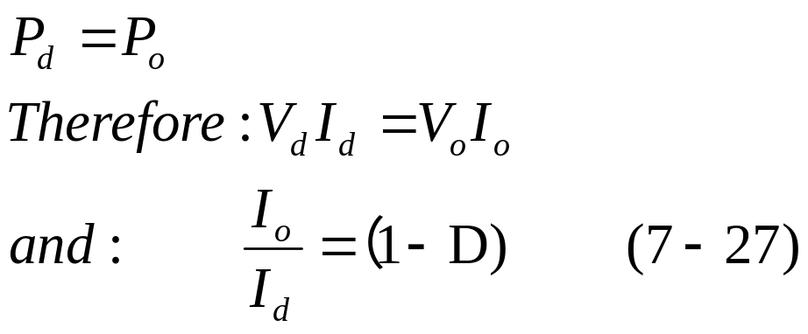
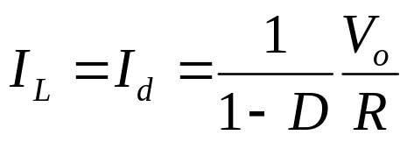
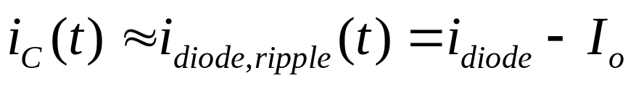
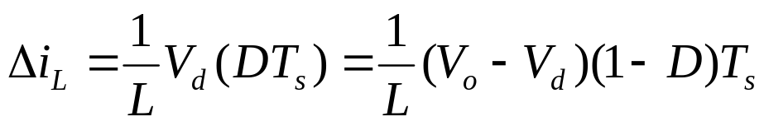
7-4 BOOST CONVERTER
Assuming a lossless circuit,
i
L
D
i_{D}
L
+
+
V
-
L
+
(a)
i
s
C
R
V
V
d
o
-
-
v_{L}
(V_{d})
(b)
t
(V_{d}-V_{o})
T_{s}
i_{L}
(c)
I_{L}
0
t
t_{on}
t_{off}
i_{s}
(d)
0
t
i_{D}
(e)
0
t

Slide 7
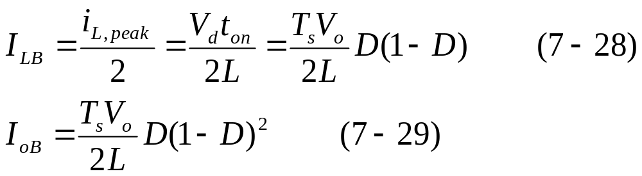
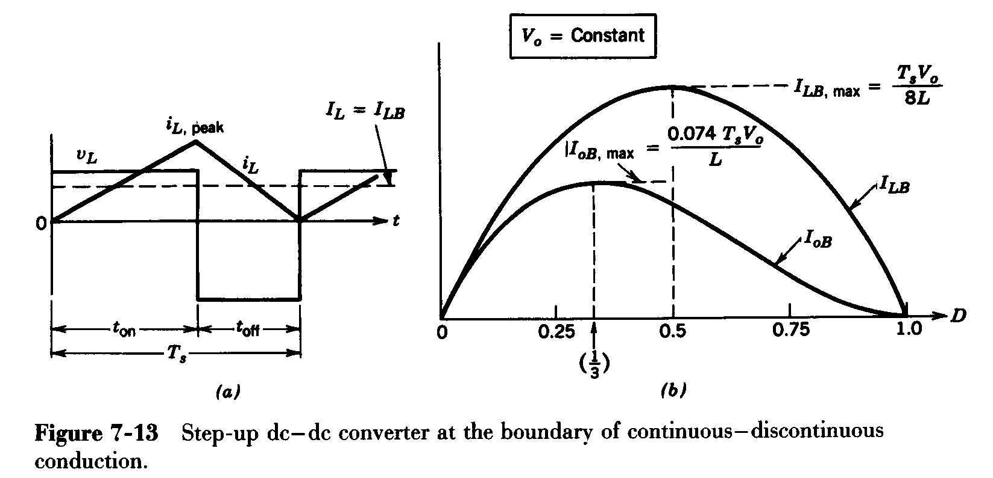
7-4-2 Boundary between continuous and discontinuous-conduction mode
For a constant V_{o}

Slide 8
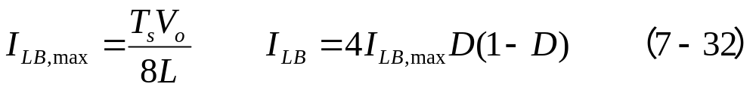
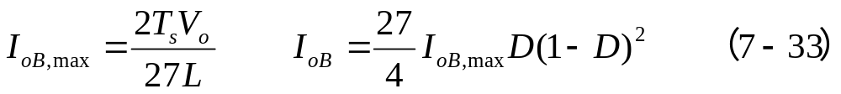

7-4-2 Boundary between continuous and discontinuous-conduction mode
The maximum value of I_{LB} occurs at D=0.5.
The maximum value of I_{oB} occurs at D=1/3

Slide 9
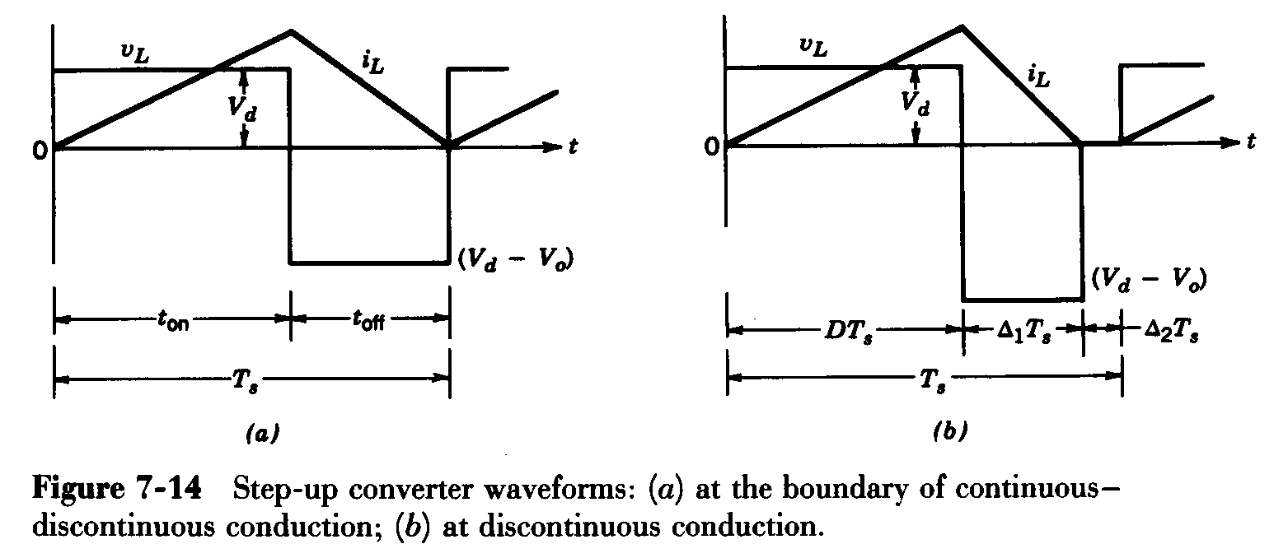
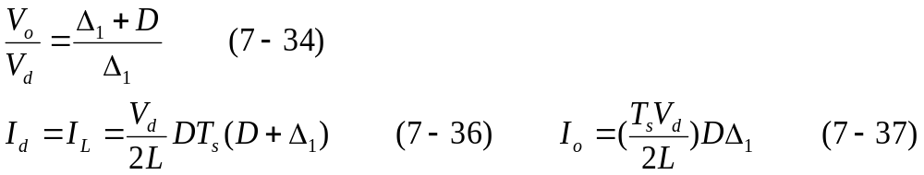
7-4 BOOST CONVERTER
7-4-3 discontinuous-conduction mode
Occurs at light loads

Slide 10
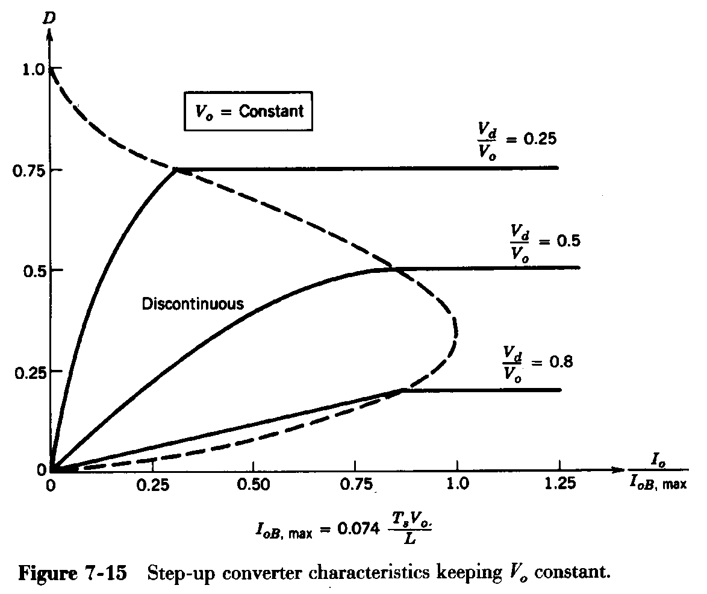
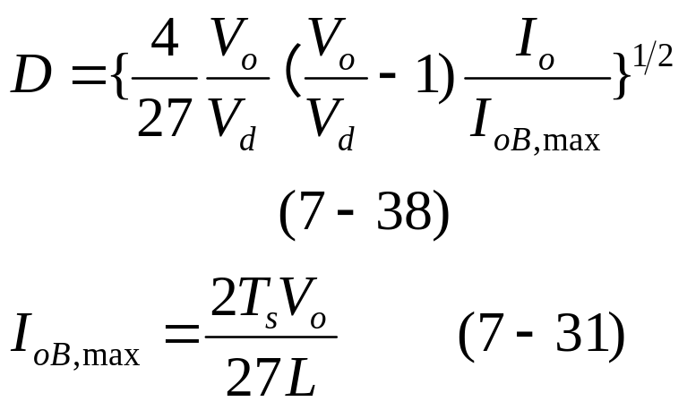
7-4 BOOST CONVERTER
Step-Up DC-DC Converter: Limits of Cont./Discont. Conduction
For a constant V_{o}

Slide 11
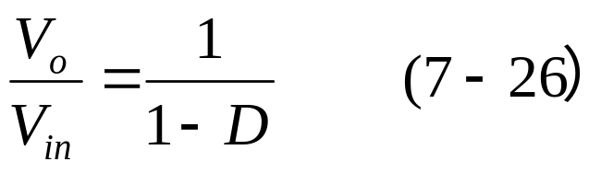
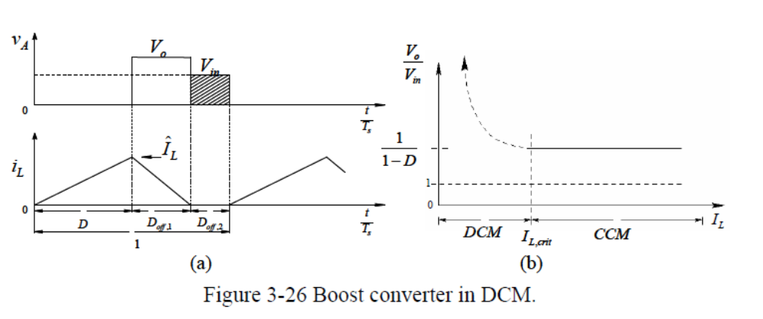
7-4 BOOST CONVERTER
Boost converter: voltage transfer ratio
The voltage conversion ratio of Boost converters operating in CCM depends on D, but is independent of the output load. If the output load decreases to the extent that i_{L} becomes discontinuous (DCM), the relationship (7-26) is no longer valid.
Which one will have higher output voltage? CCM or DCM?

Slide 12
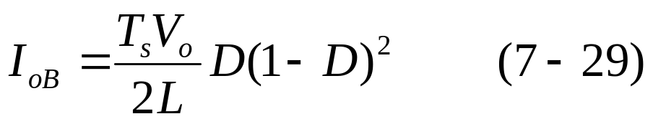
7-4 BOOST CONVERTER
Example 7-1
In a step-up converter, the duty ratio is adjusted to regulate the output voltage V_{o} at 48V. The input voltage varies in a wide range from 12 to 36V. The maximum power output is 120W. For stability reasons, it is required that the converter always operate in a discontinuous-current-conduction mode. The switching frequency is 50kHz. Assuming ideal component and C as very large. Calculate the maximum value of L that can be used.
solution
In this converter, V_{o}=48V, T_{s}=20µs, and I_{o,max}=120W/48V=2.5A.
DCM BOUNDARY

Slide 13
7-4 BOOST CONVERTER
solution
Assume that at the extreme operating condition, the inductor current is at the edge of continuous conduction.
For the V_{d}(12~36V), D=0.75~0.25. for this range of D, from Fig. 7-13b, I_{oB} has the smallest value at D=0.75.

Slide 14
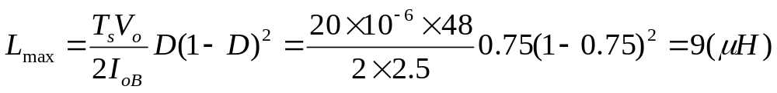
7-4 BOOST CONVERTER
Solution
Therefore, from Eq. 7-29
To further ensure a discontinuous-conduction mode, a smaller than 9 µH inductance may be used.

Slide 15
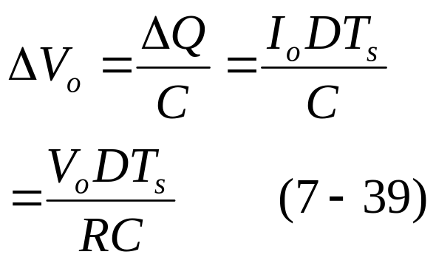
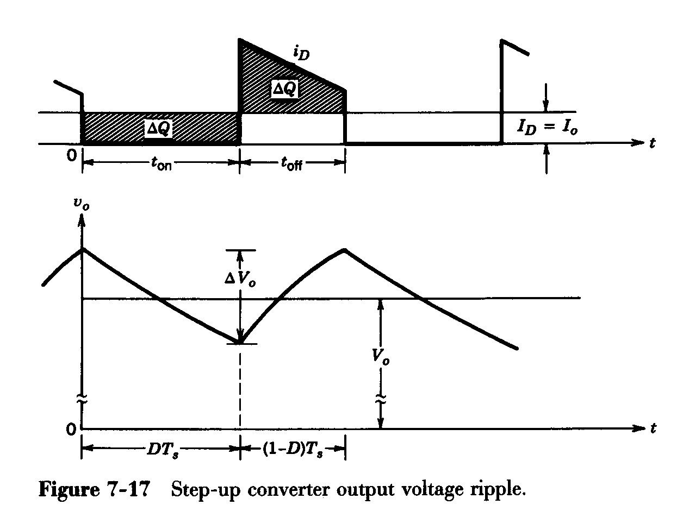
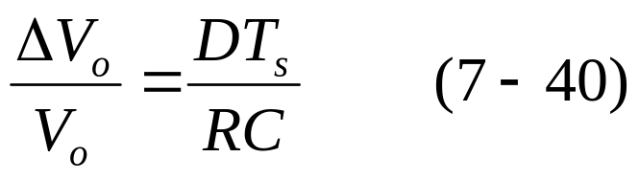
7-4 BOOST CONVERTER
7-4-5 output voltage ripple
!! For a continuous-conduction mode
The ripple is dependent of the output load power.

Slide 16
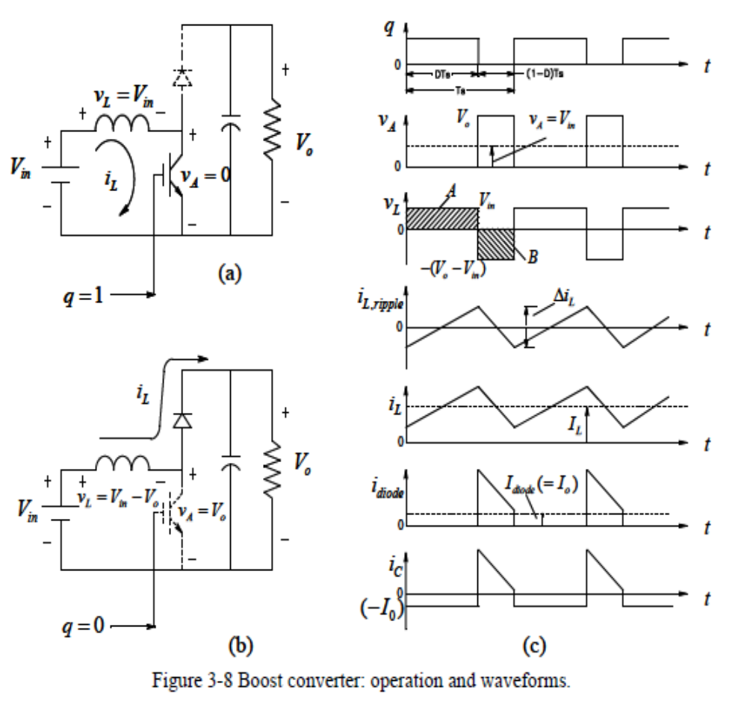
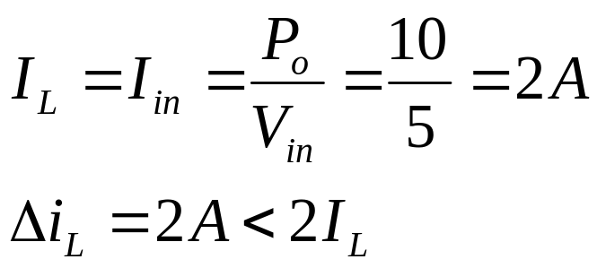
7-4 BOOST CONVERTER
Example 7-B In the following Boost converter, the inductor current has Δi_{L}= 2A. It is operating in dc steady state under the following conditions: V_{in} =5V , V_{o} =12V ,P_{o}=10W , and f_{s}=200kHz .
Assuming ideal components,
calculate L and draw the
waveforms.
Solution
Continuous conduction mode

Slide 17
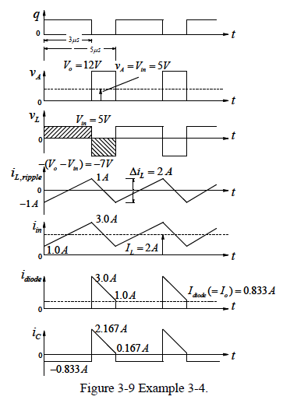
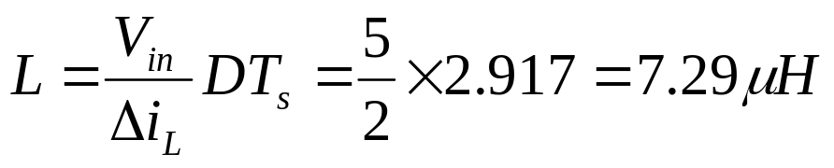
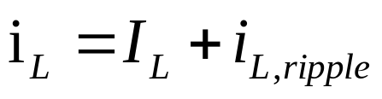
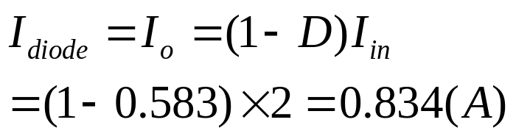
7-4 BOOST CONVERTER
Solution
D=(V_{o}-V_{d})/V_{o}=0.583 , f_{s}=200kHz , T_{s}= 5μs and T_{on}=DT_{s} =2.917μs . v_{L} fluctuates between V_{in} =5V and −(V_{o} −V_{in} )=−7V .

Slide 18
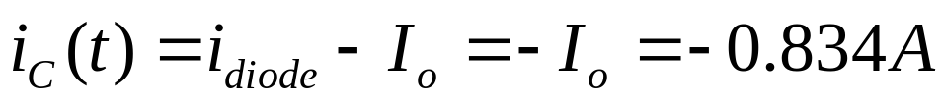
7-4 BOOST CONVERTER
Solution
When the transistor is on, the i_{diode} = 0,
The capacitor current jumps to a value of 2.167 A and drops to （1− 0.833 ）= 0.167 A.

Slide 19
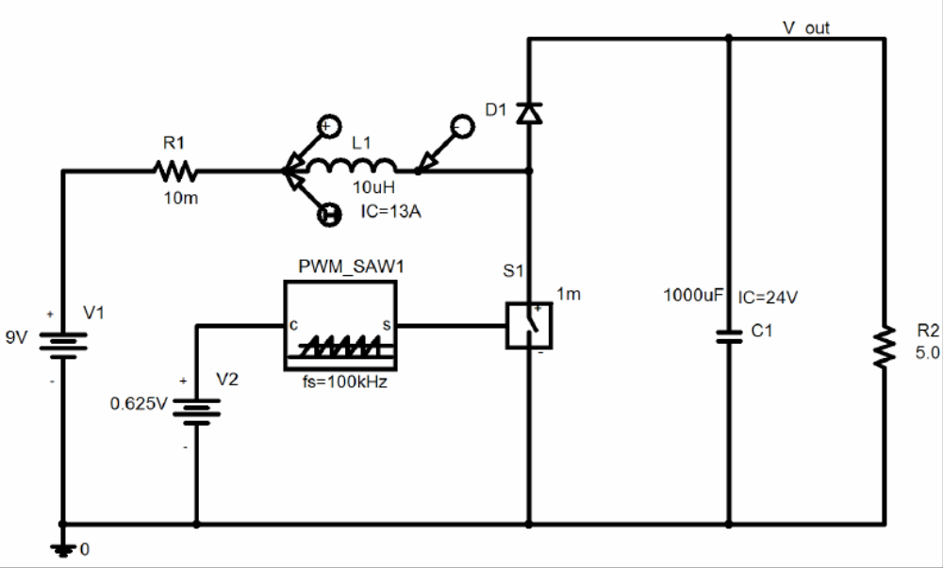
7-4 BOOST CONVERTER
PSpice Modeling: C:\FirstCourse_PE_Book03\Boost.sch

Slide 20
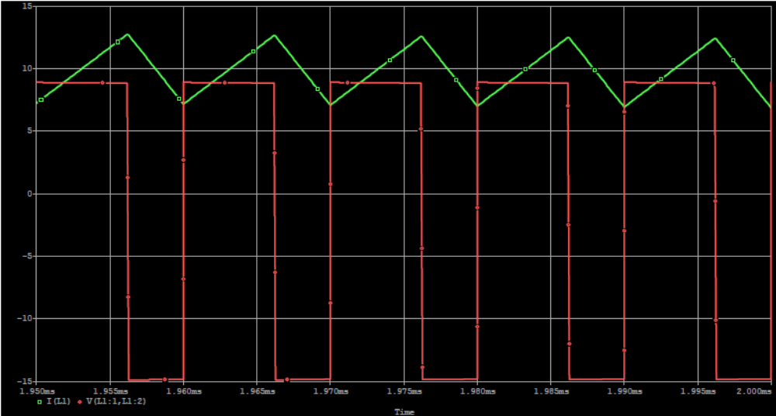
7-4 BOOST CONVERTER
Simulation Results

